Slide 1
Conceptual Framework for Estimating LLIN Impact
OpenMalaria simulation model
Demography
Seasonality
Vector species
Health system access
Transmission intensity scenarios (EIR sweep)
Low EIR
Moderate EIR
High EIR
LLIN usage scenarios
Counterfactual baseline
LLIN usage=0
Non-user prevalence
0% → 80% usage
LLIN Users
Non-users
Population Stratification (0 – 100 years)
Users and non-users coexist
Analysis of simulation outputs

Slide 2


Conceptual Framework for Estimating LLIN Impact
OpenMalaria simulation model
Ghana demography
Seasonality
Vector species
Transmission intensity scenarios (EIR sweep)
Low PfPR
Moderate PfPR
High PfPR
Population stratification (LLIN use)
Counterfactual baseline
LLIN usage=0
Non-user prevalence
Proportion of population using LLIN (0% → 80% )
Rest of the population at each usage level
LLIN Users
Non-users
Population Stratification (Age)
Analysis outputs
Direct protection
Prevalence reduction among LLIN users
(vs counterfactual)
Indirect protection
Prevalence reduction among non-users
(vs counterfactual)
Overall protection
Population-weighted prevalence reduction
(vs counterfactual)

Slide 3
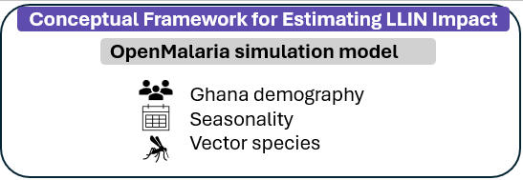
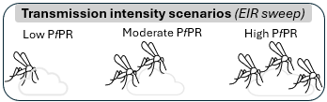
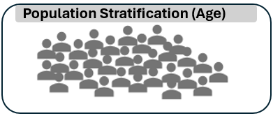
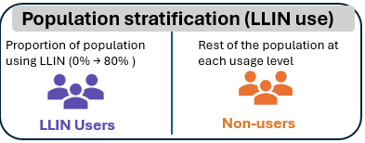

Counterfactual
Non-user prevalence at LLIN usage=0
Population
Users and non-users coexist
Analysis outputs
User protection
Prevalence reduction among LLIN users
(vs counterfactual)
Non-user (community) protection
Prevalence reduction among non-users
(vs counterfactual)

Slide 4
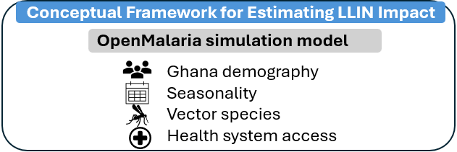
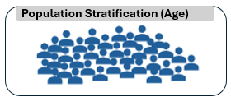
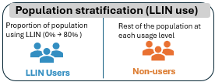

Counterfactual
Non-user prevalence at LLIN usage=0
Population
Users and non-users coexist
Analysis outputs
User protection
Prevalence reduction among LLIN users
(vs counterfactual)
Non-user (community) protection
Prevalence reduction among non-users
(vs counterfactual)

Slide 5
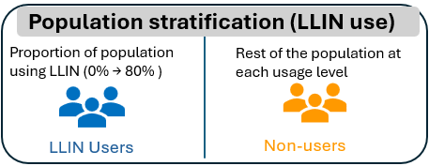

Counterfactual
Non-user prevalence at LLIN usage=0
Population
Users and non-users coexist
Analysis outputs
User protection
Prevalence reduction among LLIN users
(vs counterfactual)
Non-user (community) protection
Prevalence reduction among non-users
(vs counterfactual)

